Slide 1




WELCOME TO OUR
كِـ TABOOK

Slide 2

THE PROBLEM DEFINITION
WHY WE STARTED?

Slide 3



WHY WE STARTED?
TIRED OF BORING PDF READERS AND MESSY BOOK PLATFORMS?
كِـTabook is your all-in-one smart eBook platform. We created a digital library that offers reading, listening, community interaction, and personalized recommendations — all in one place.

Slide 4


WHY كِـ TABOOK IS DIFFERENT ?

Slide 5





كِـ TABOOK
OTHER PLATFORMS
BUILT-IN AI
NOT INTEGRATED
TEXT-TO-SPEECH
BASED ON
USER DATA
STATIC/POPULAR
BOOKS ONLY
SMART RECOMMENDATIONS
FULL POSTS AND
MESSAGING
ONLY REVIEWS/
COMMENTS
COMMUNITY INTERACTION
MULTILINGUAL READY
YES
LIMITED
ADMIN CONTROL PANEL
ADVANCED TOOLS
BASIC OR NONE

Slide 6
CORE FEATURES
OUR PROJECT CORE FEATURES

Slide 7

CORE FEATURES
READ BOOKS ONLINE (SEARCH, BROWSE, FAVORITE)
COMMUNITIES: POSTS, COMMENTS, PRIVATE MESSAGES
DASHBOARD WITH READING STATS AND INSIGHTS
ADMIN DASHBOARD: BOOK/USER MANAGEMENT, CONTENT MODERATION
PERSONALIZED BOOK RECOMMENDATIONSAND AI MODERATOR
TEXT-TO-SPEECH (AI-POWERED VOICE READING )

Slide 8


THE POWER OF AI IN كِـ TABOOK
We used artificial intelligence to enhance
the reading experience:
.Text-to-Speech: Convert book content into natural-sounding audio
. Recommendation System: Suggest books based on user behavior, interests,
and activity history Personalized and inclusive for all reader types.
.AI Based Moderator: to automatically detect and filter toxic or inappropriate
user posts using natural language processing.

Slide 9

OUR DATASET

Slide 10
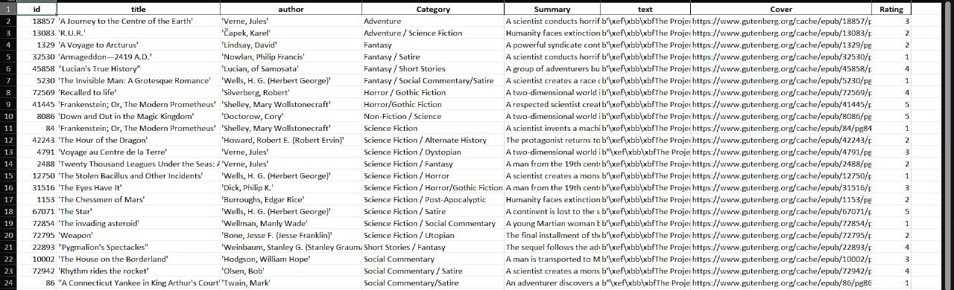
The dataset contains almost 12,000 books. Here is a snapshot .

Slide 11
HOW كـ TABOOK WORKS?
-USER SIGNS IN
-SEARCHES OR SELECTS A BOOK
-READS OR LISTENS VIA TTS
-SYSTEM TRACKS ACTIVITY
-RECOMMENDATION ENGINE UPDATES SUGGESTIONS
-ADMIN MONITORS CONTENT

Slide 12

كِـ TABOOK ISN'T JUST A SITE — IT'S A SMARTER, MORE HUMAN WAY TO ENJOY BOOKS.
For global readers who prefer listening.
For students needing smarter study tools.
For curious minds who want community & discussion Read, listen, connect — with كِـTabook.

Slide 13
FUTURE
WORK
OUR AMBITION..

Slide 14
FUTURE WORK
Deep Learning recommender engine for smarter suggestions.
Mobile app version of كِـ Tabook .
Voice-based search , navigation and Sound E book Option .
Advanced AI content moderation tools .
We plan to integrate a group video meeting feature
Finally we aim to improve platform’s experience for children.

Slide 15



PRESENTED BY
RANA MOHAMED
SHAIMAA NABIL
FATMA AYMAN
MAHMOUD BADAWY
MAHMOUD TALAAT
MOHAMED AMR

Slide 16

THANK
YOU
FOR YOUR ATTENTION
SUPERVISED BY
DR/ MAI ELDEFRAWI

